Slide 1
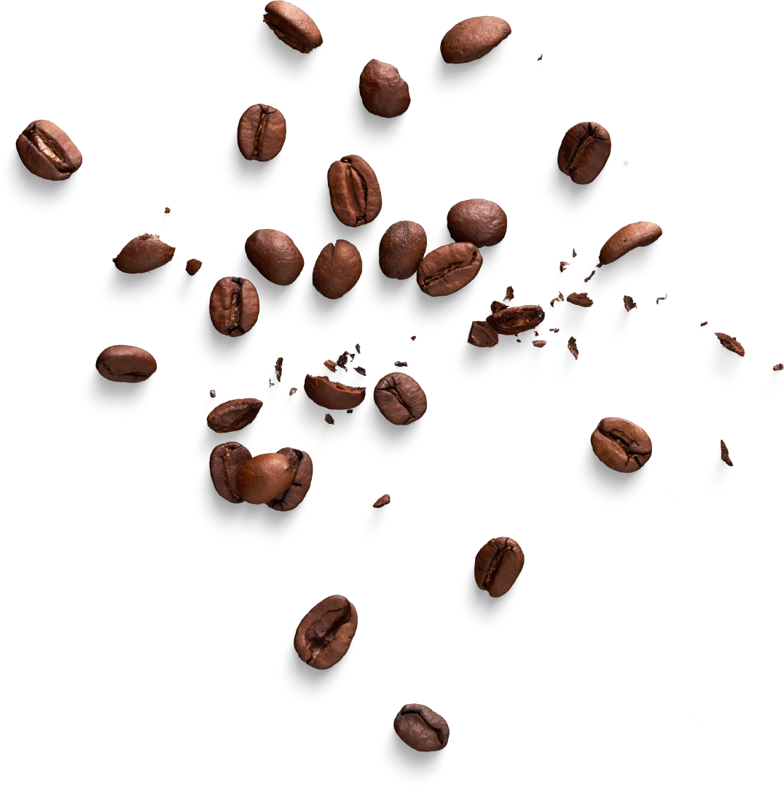
Group #2
Coffee
Unstructured Data Management: Group Project
Archit Chawla
Robby Connor
Ayush Rishi
Kulsum Khanam Nayyar

Slide 2
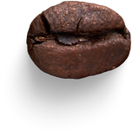

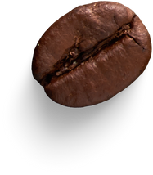
Contents
Introduction
Preprocessing & EDA
Sentiment Analysis
Data Visualization
ML Modeling
Conclusions & Takeaways

Slide 3
1. Introduction
Notes:
Archit

Slide 4



Coffee!
So which coffee is the best?
Everyone loves coffee!
But everyone has different preferences for how they like their coffee
What roles do origins & roasts, and other factors play in determining which is the best coffee?
Notes:
Archit
For example for flavor profiles:
Colombian coffee can be creamy and light, and has the kind of flavor profile most people imagine when they think of coffee
Italian coffee can be smokey and can have hints of cocoa.
Ethiopian coffee is world renowned for its incredibly fruity flavor profile.

Slide 5
The Dataset
Covers a variety of factors in determining coffee:
Name
Roaster
Roast Type
Origins
Price per 100 grams in USD ($)
Text Reviews
Notes:
Ayush "The dataset we used covers several factors that influence coffee quality, such as the name, roaster, roast type, origins, price, and text reviews. This data will help us analyze how these attributes relate to coffee ratings."

Slide 6
2. Preprocessing & EDA
Notes:
Ayush

Slide 7
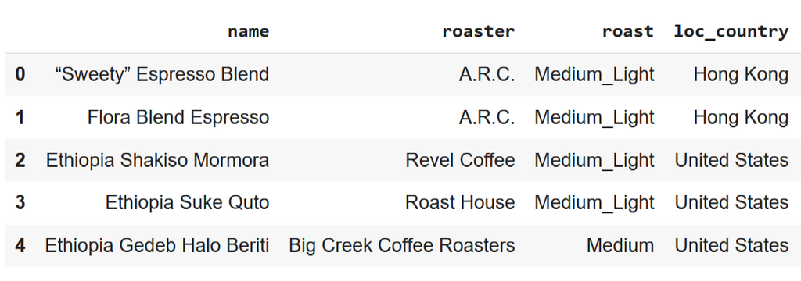
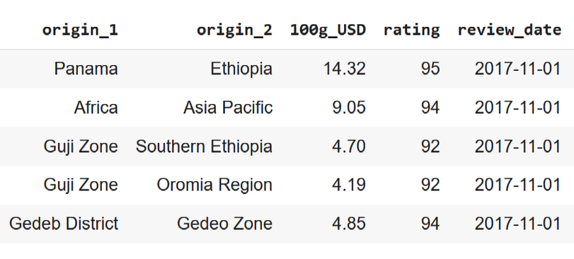

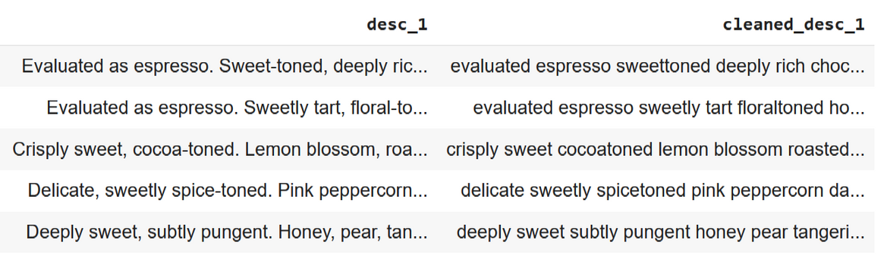
Data Preprocessing
General Preprocessing
Text Cleaning & NLP
Dropping unnecessary columns
Checking for null values
Imputing based on roast distribution & region of origin where necessary
Lowercasing Text
Stop Word Removal
Text Lemmatization
Other General Cleaning
Topic Modeling with LDA
Sentiment Analysis with VADER & RoBERTA
Notes:
Ayush In this part, we'll walk through the preprocessing steps we took, including data cleaning, handling missing values, and preparing the text for analysis. We also performed exploratory data analysis to get a better understanding of the dataset. We started with basic text preprocessing like lowercasing, removing stop words, and lemmatization. We then performed topic modeling with LDA and sentiment analysis using VADER and RoBERTa. This helped us streamline the data for further analysis.

Slide 8
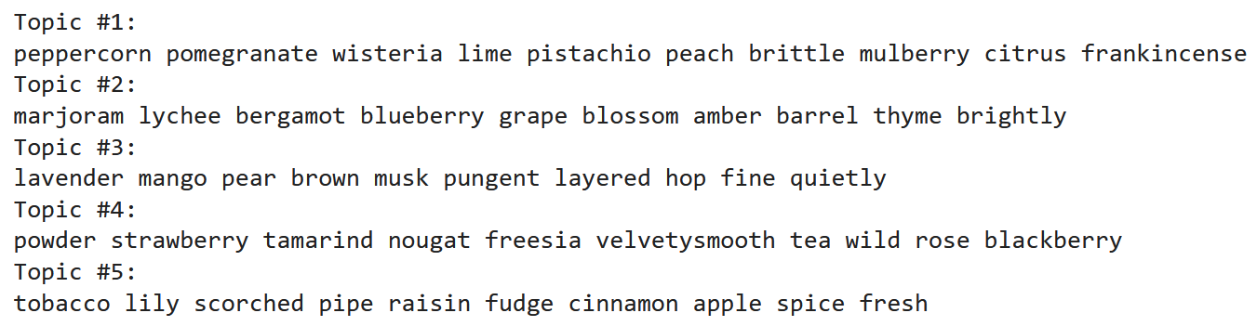
Top 5 topics with LDA
People tend to like their coffees to have a citrusy & fruity flavor while being aromatic & having a smooth texture!
Notes:
Robby

Slide 9
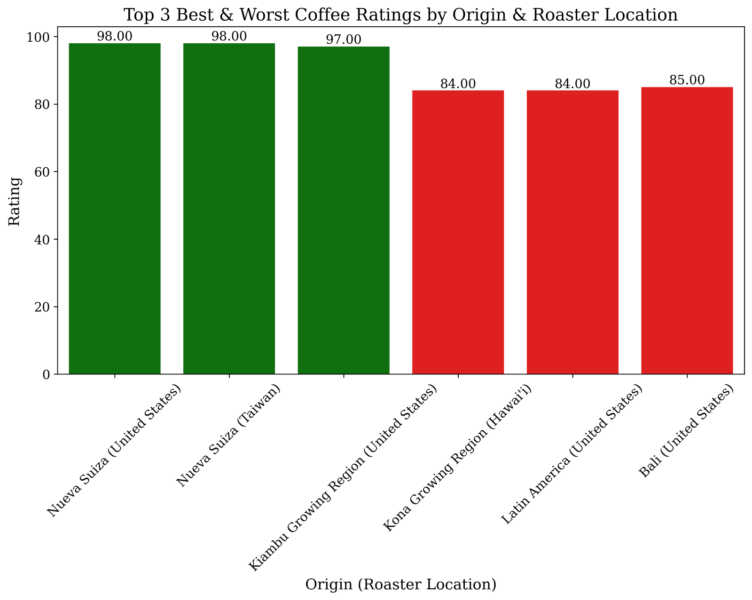
Which origin & Roaster locations have the 3 best ratings, and which have the 3 worst ratings?
Notes:
nuev

Slide 10
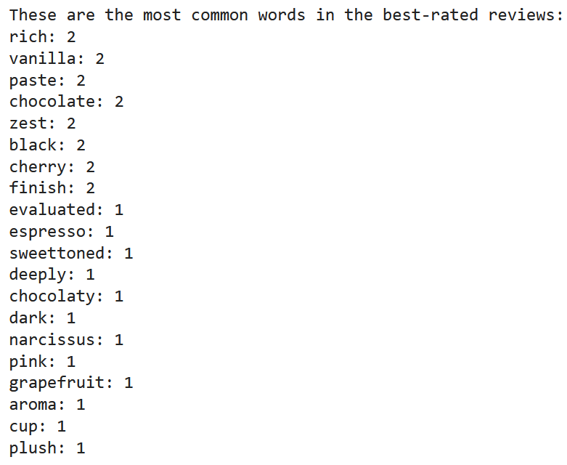
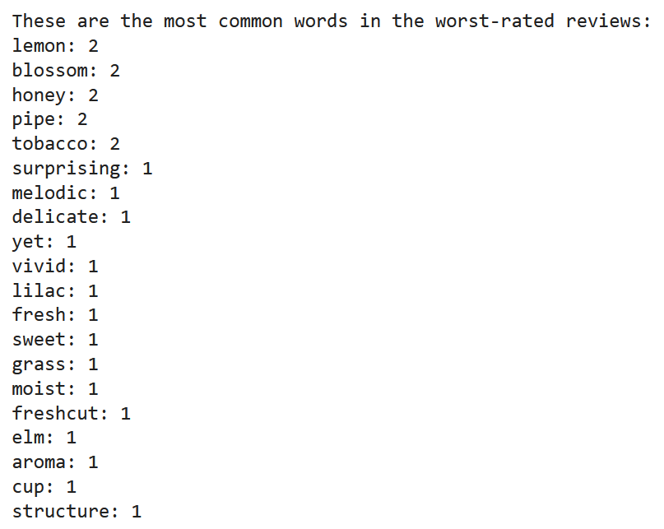
What kinds of words are associated with the best & worst ratings?
Words associated with the best reviews:
Words associated with the worst reviews:

Slide 11
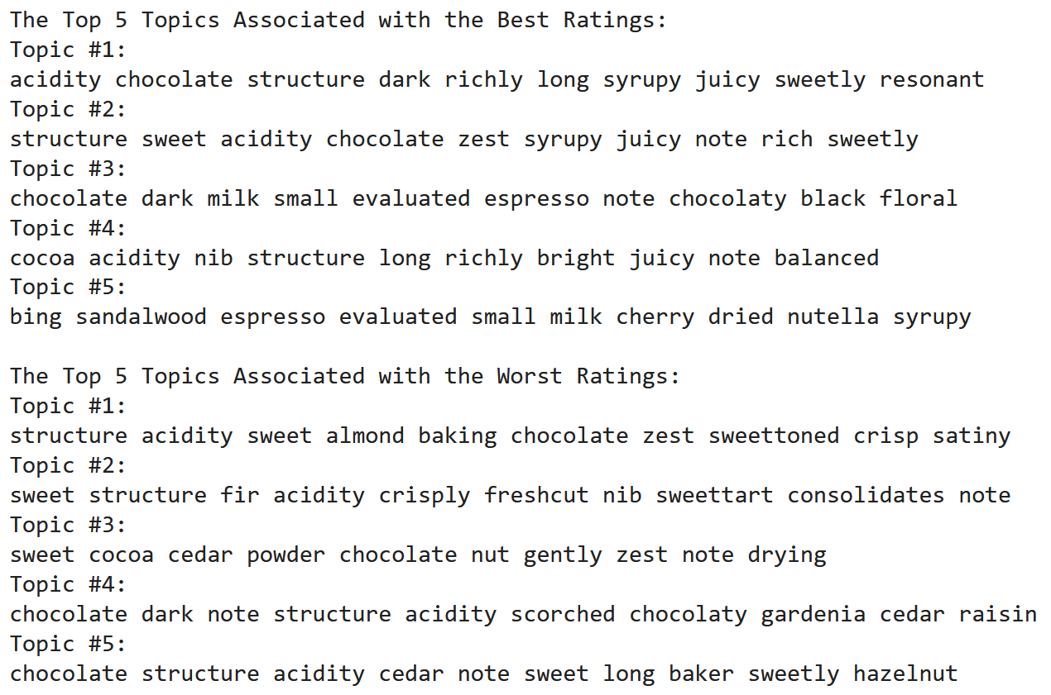
What kinds of topics are associated with the best & worst ratings?

Slide 12
3. Sentiment Analysis
Notes:
Archit

Slide 13
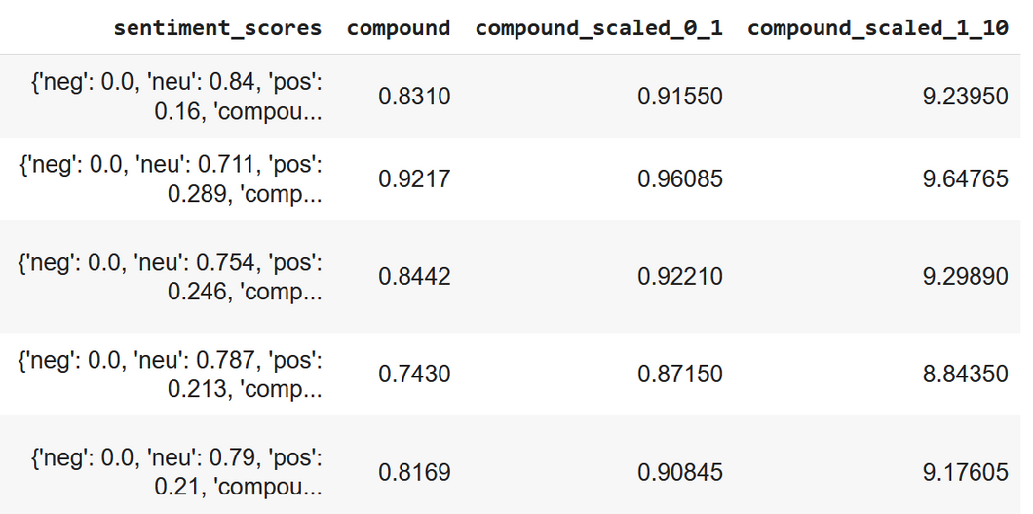
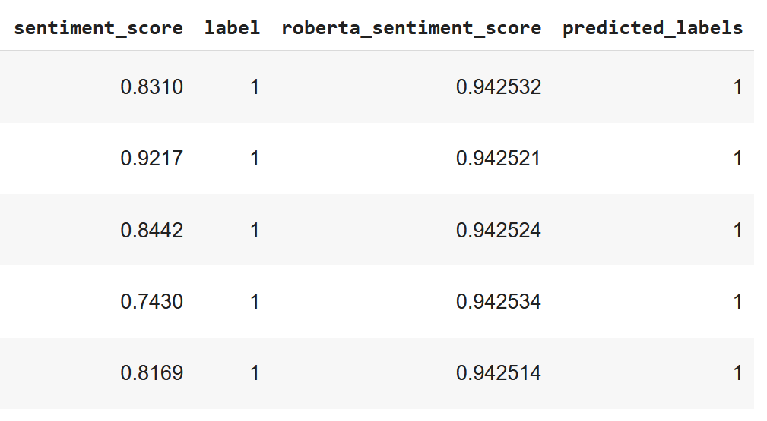
VADER vs. RoBERTa: Sentiment Analysis Results
VADER Sentiment Analysis Results
RoBERTa Sentiment Analysis Results
Notes:
BERT—Masked Language Model (Google, 2018)
Learns by masking a word and using the context words to predict it—sort of like CBoW in Word2Vec
Our RoBERTa model—124, 647,170 parameters, a 90/10 training/validation split, batch size of 16 to allow it to generalize better on the data & avoid overfitting, and 3 epochs so it ran over the data 3 times. We got ~98% accuracy on the training runs and ~97% on the validation runs.

Slide 14
VADER vs. RoBERTa
Why did we run both VADER & RoBERTa?
Well, VADER gives us a generalized sentiment analysis with a fairly simple implementation process.
BERT, and for this case, specifically its RoBERTa variant, can better analyze the nuances of the text in a more detailed way than VADER can, but it requires more fine-tuning and is more computationally expensive.
To compare the results:
VADER gave us a fairly positive overall sentiment analysis, but it didn’t capture some of the more positive nuances in the reviews; RoBERTa was better able to capture those positive nuances.
We did our ML modeling with both sets of results so that we could compare how well they each performed when trained on the same classification problems.
Notes:
Archit

Slide 15
4. Data Visualization
Notes:
Kulsum
Now , let's talk about the Data Visualization portion of our project. Visualizing the data allowed us to uncover patterns and trends that were otherwise hidden in the raw dataset. We used various types of visualizations, such as box plots, violin plots, and word clouds, to explore relationships between variables like roast types, ratings, and sentiment scores. These visualizations provided key insights that guided our analysis and helped us better understand customer preferences for different coffee roasts.

Slide 16
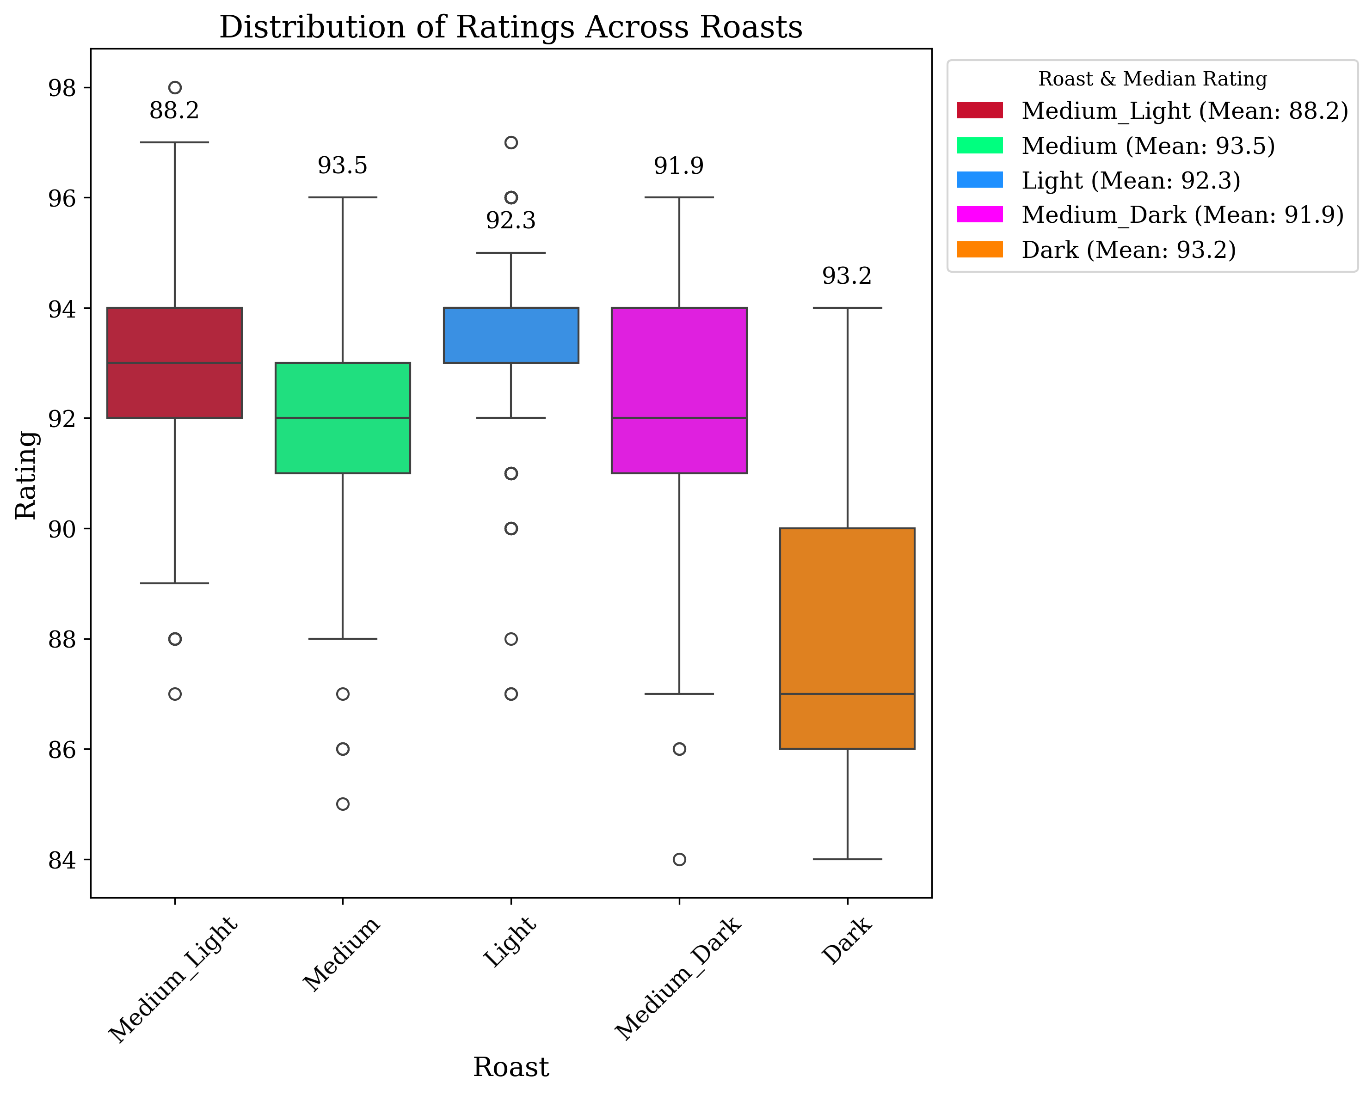
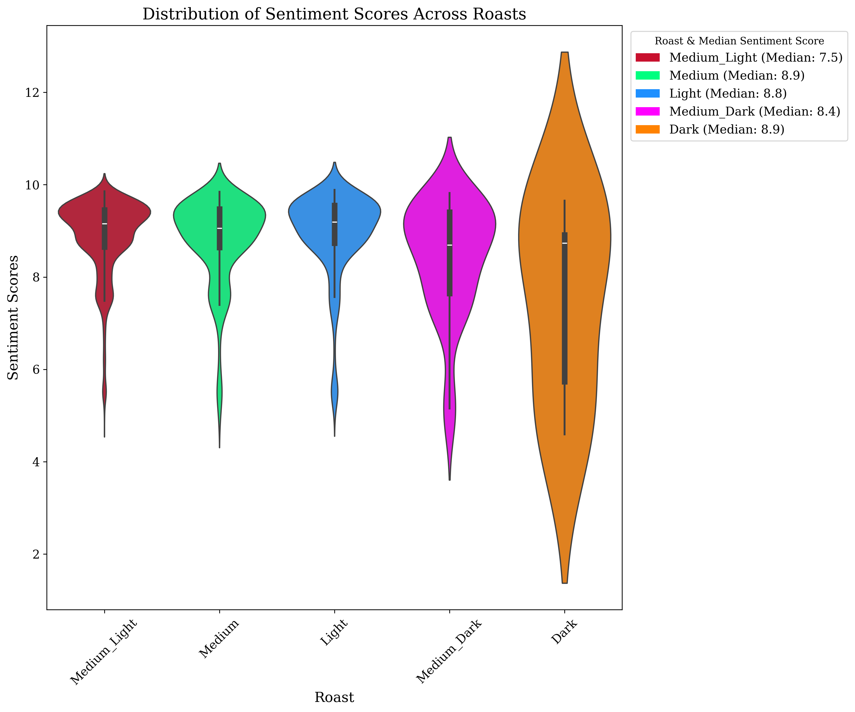
Distribution of Ratings & Sentiment Scores across Roasts
Notes:
Kulsum
We visualized the distribution of ratings and sentiment scores across different roast levels to identify how various roast types are perceived by customers.
On the left, we have a box plot representing the distribution of ratings for five roast levels: Medium Light, Medium, Light, Medium Dark, and Dark.
The mean rating for each roast level is displayed in the legend.
As we can see, the Medium roast has the highest average rating at 93.5, followed by Dark at 93.2. Medium Light, on the other hand, has the lowest average rating at 88.2.
On the right, we have a violin plot showing the distribution of sentiment scores across the same roast levels.
The sentiment scores help us understand the emotional tone of the reviews.
Here, Medium and Dark roasts show the highest median sentiment scores, indicating a generally positive perception. In contrast, Medium Light shows a lower sentiment score, suggesting more mixed or negative feedback.
These visualizations helped us correlate the roast levels with both objective ratings and subjective sentiment, providing a clearer picture of customer preferences

Slide 17
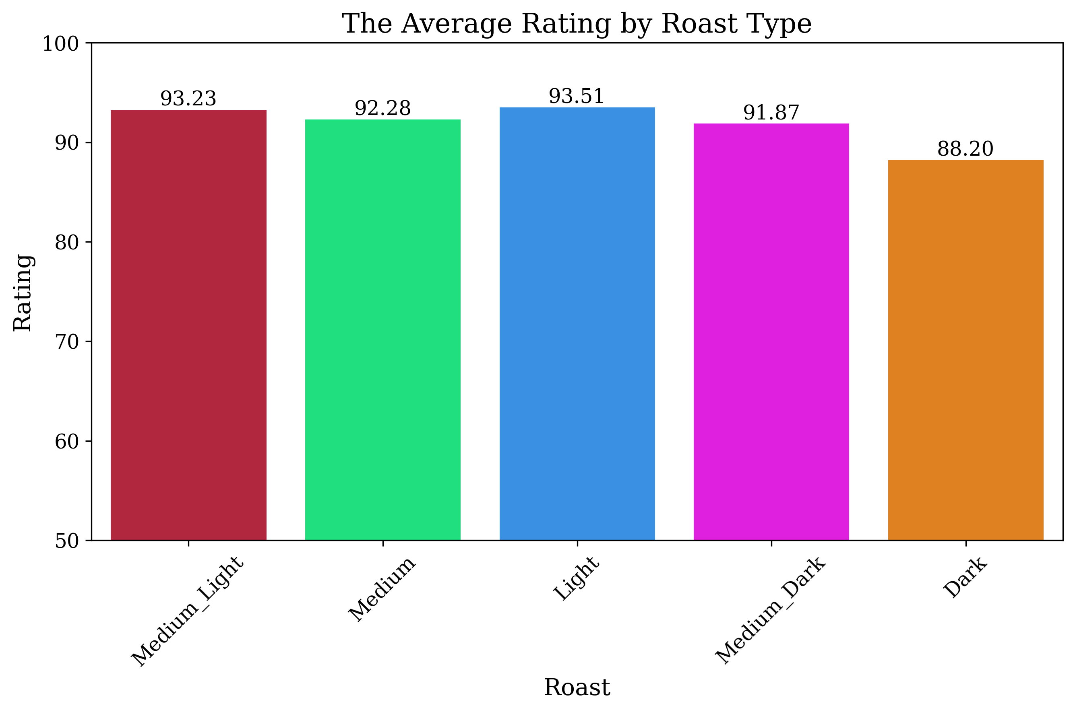
Average Rating by Roast Type
Notes:
Robby

Slide 18
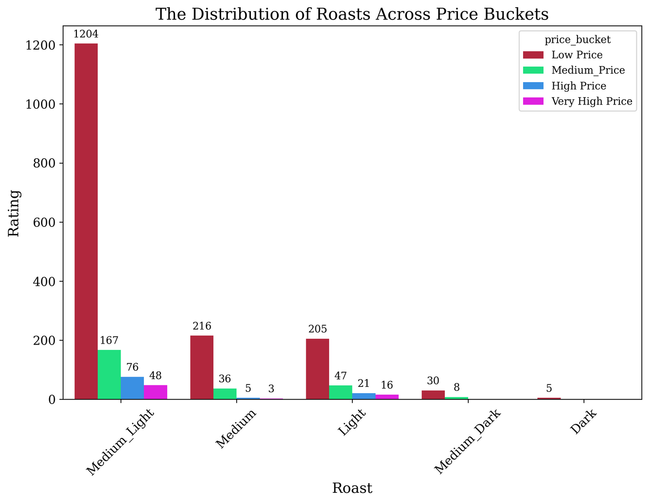
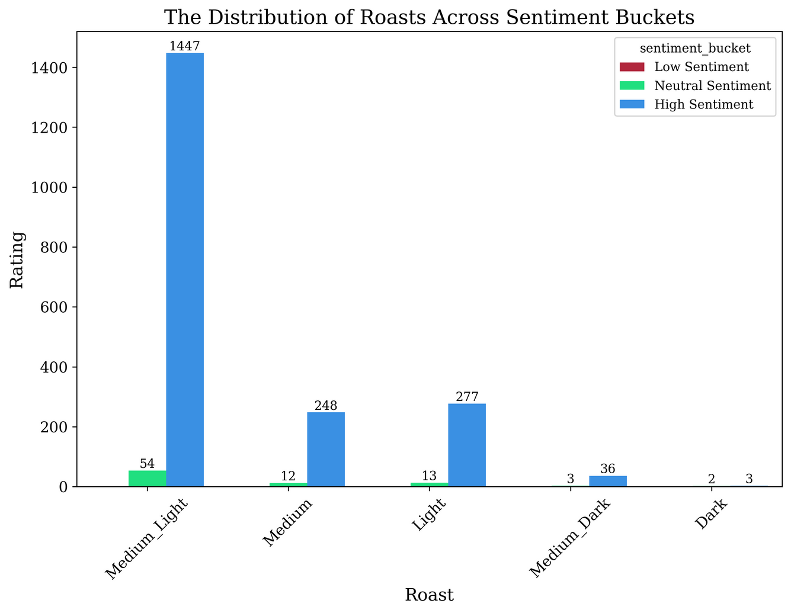
Distribution of Roasts across Price & Sentiment Buckets

Slide 19
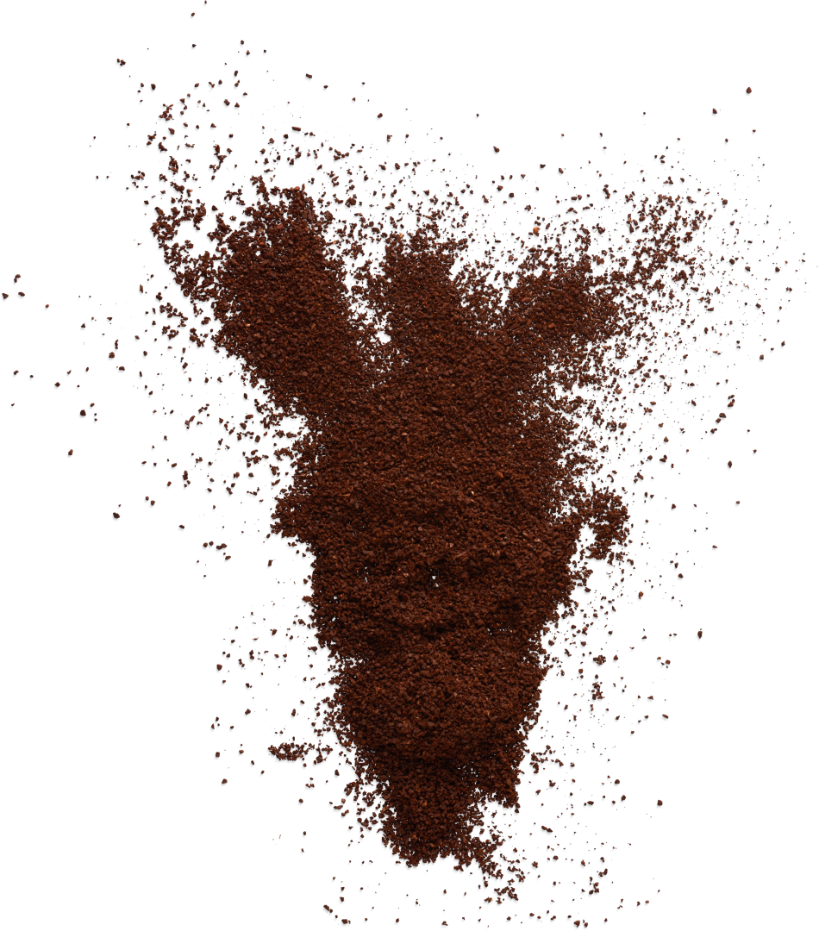
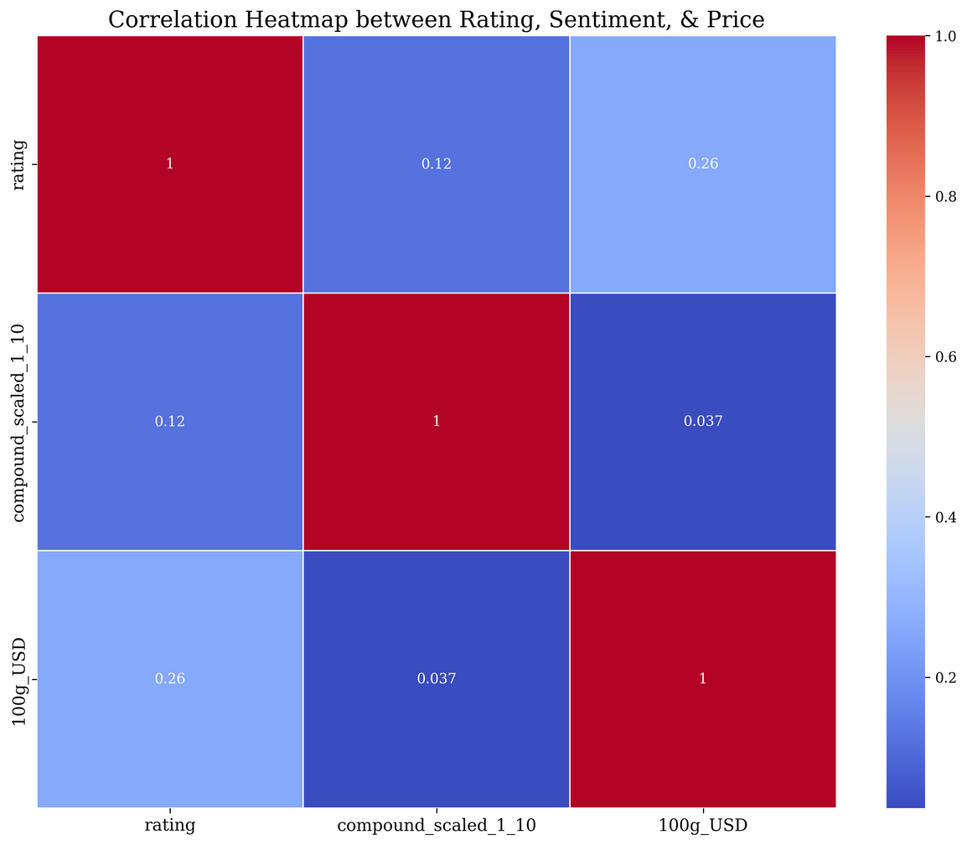
Correlation between Rating, Sentiment, & Price
Notes:
Robby

Slide 20
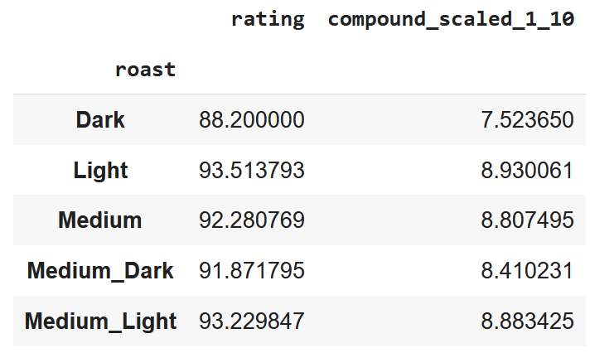
Roast Summary matched with Sentiment Analysis
Notes:
Ayush By matching roast summaries with sentiment analysis, we observed that certain roasts are associated with higher positive sentiments, further validating our findings from the data.

Slide 21
5. ML Modeling
Notes:
Ayush Now, let's move on to the machine learning models we implemented to predict coffee ratings and price categories. We used several models to determine which performed the best.

Slide 22
ML Models: Accuracy Results
VADER:
Price Bucket Classification
Random Forest
Accuracy: 91.65%
KNN Accuracy: 87.23%
XGB Accuracy: 95.30%
Rating Bucket Classification
Random Forest
Accuracy: 89.68%
KNN Accuracy: 85.17%
XGB Accuracy: 93.36%
RoBERTa:
Price Bucket Classification
Random Forest Accuracy: 88.33%
KNN Accuracy: 84.98%
XGB Accuracy: 91.81%
Rating Bucket Classification
Random Forest Accuracy: 86.70%
KNN Accuracy: 85.59%
XGB Accuracy: 95.28%
Notes:
Ayush We tested different models like Random Forest, KNN, and XGB. For both price and rating classifications, the XGB model achieved the highest accuracy, making it the most effective choice.

Slide 23
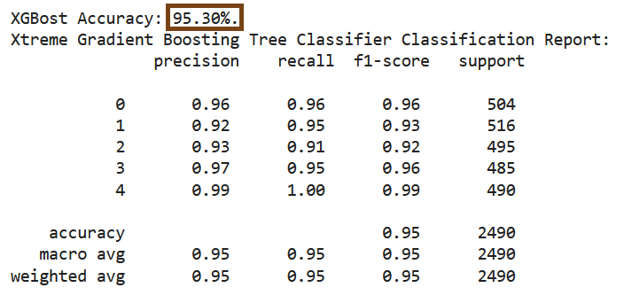
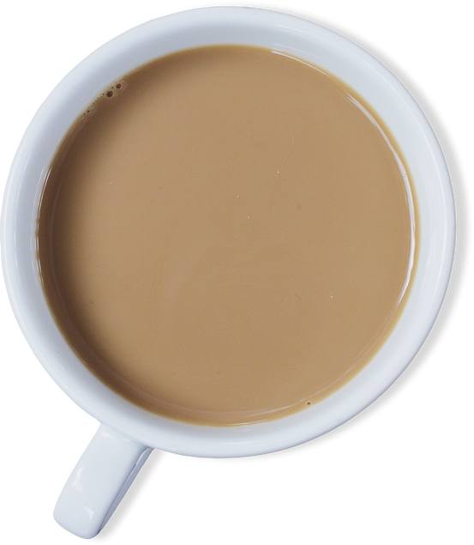

Best Model for Price Bucket Classification
X-Treme Gradient Boosting Classifier
Accuracy: 95.30%
Cross-Validated Average Accuracy: 94.41%
Notes:
Robby

Slide 24
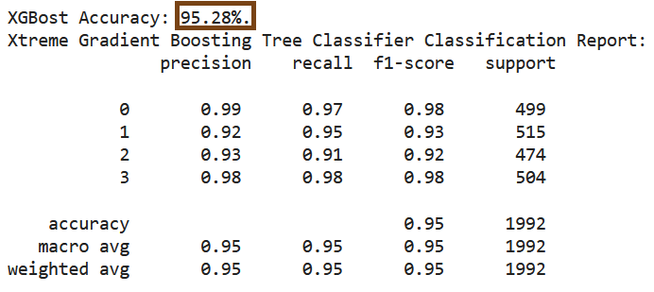

Best Model for Rating Bucket Classification
X-Treme Gradient Boosting Classifier
Accuracy: 95.28%
Cross-Validated Average Accuracy: 93.72%
Notes:
Robby

Slide 25
6. Conclusions & Takeaways
Notes:
Robby

Slide 26
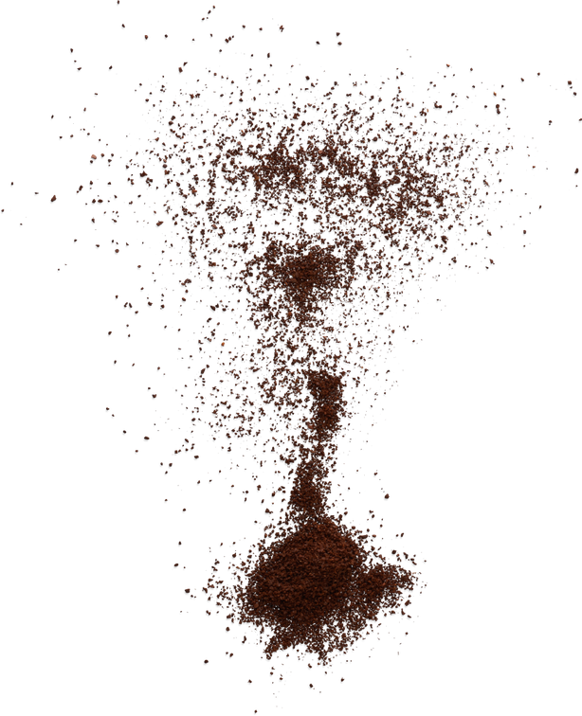
Conclusions & Takeaways
Most Popular Roaster: Kakalove Café
Ethiopian Natural Yirgacheffe Tore Coffee
Medium-Light Roast
Average price per 100 grams (USD): $6.52
People prefer for their coffee roasts to be right in that sweet spot of medium-light—why is that?
Lighter roast coffees tend to be better at showcasing the coffee bean’s natural flavors, rather than letting its bitterness dominate the taste.
With Ethiopian Yirgacheffe Tore coffee, it tends to have a distinctively lemon citrus & candied fruit sweet flavor with a lighter body.
So a lighter roast with that flavor profile allows drinkers to better experience the coffee’s flavor, which makes it the most popular coffee!
Notes:
Robby

Slide 27
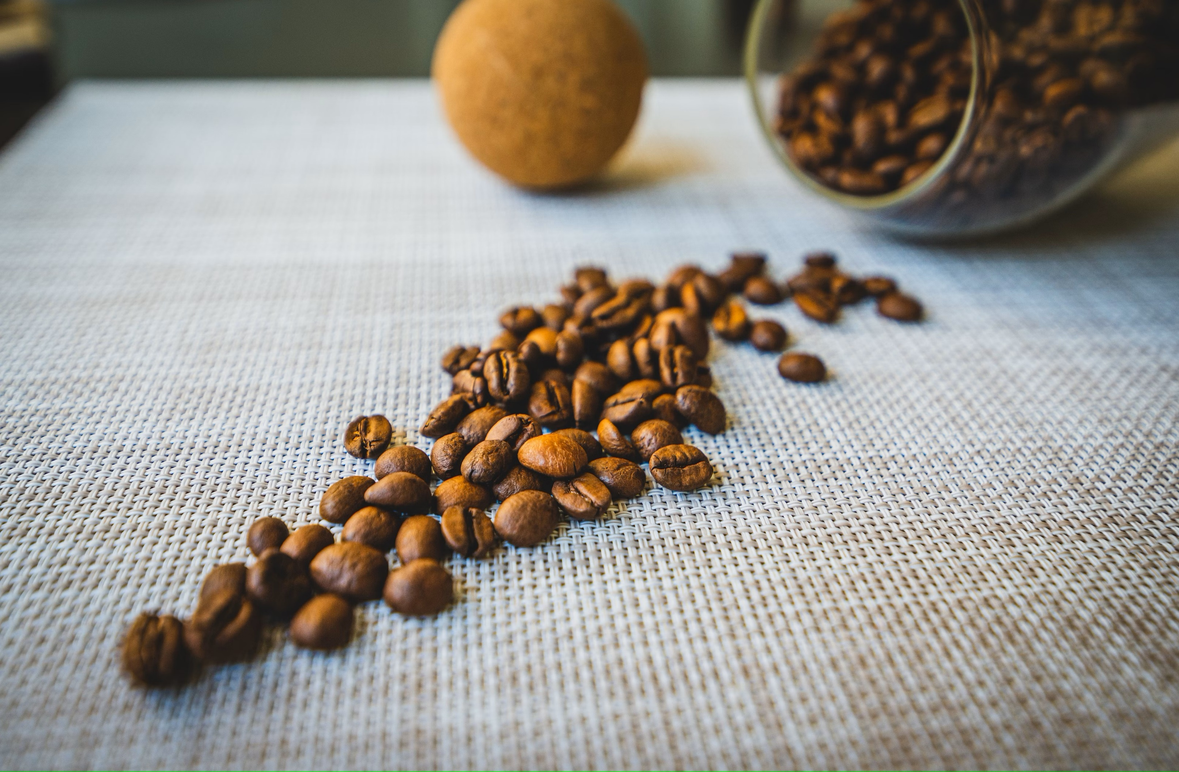
The End
Notes:
Robby

Slide 28
Archit | Ayush | Kulsum | Robby
1—Introduction | 5—The Dataset | 16—Chart | 8—LDA
2—Contents | 6—Preprocessing | 17—Chart | 9—Chart
4—Coffee | 7—Preprocessing | 18—Chart | 10—Chart
13—SA | 20—Chart | 19—Chart | 11—Chart
14—SA | 21—ML |  | 23—ML
 | 22—ML |  | 24—ML
 |  |  | 26—Conclusion

